Slide 1
How to Build React Apps with TypeScript
Justin Cronin – Solutions Architect
jcronin@clearedgeit.com

Slide 2
Agenda
What is React?
Overview and Philosophy
Discriminators from competitors
Evolution over time
What is a React Component?
Component Props
Component State
When a component renders

Slide 3
Agenda
What is TypeScript?
Reason for inception
Reason for adoption to a project
Types
Native Types
User-Defined Types
Composed Types
Types with Generics

Slide 4
Agenda
Starting a React app with TypeScript from scratch
Using TypeScript with React
Defining a Props Type
Adding types to Component State
Using Typed Components
Converting an existing React app to TypeScript
Questions

Slide 5
React
What it is and how to build apps with it

Slide 6
What is React?
A front end framework focused on creating interactive user interfaces both for the web and native environments
Leverages an encapsulated component-based approach to isolate behavior and combat overly complex systems
Other frameworks, such as Vue.js or Angular tends towards MVVM or MVC architecture patterns, while React by itself doesn’t push towards any one of those necessarily
Since version 16, there has been a heavy push towards functional practices, focusing mainly on Pure Functions.
A Pure Function is a function that will always give the same output when given the same input (i.e. f(x) = x + 2)

Slide 7
What constitutes a “React App”?
A React app is simply a set of components that call one another to build a user interface
A component is either a class or a function
The push from React 16 forward has been towards functional components, so we will focus on them for this talk
A functional component is a function that takes in props and returns JSX
JSX is a syntax extension that allows html like syntax in JavaScript. The goal is to bring the data and view together in one place.

Slide 8
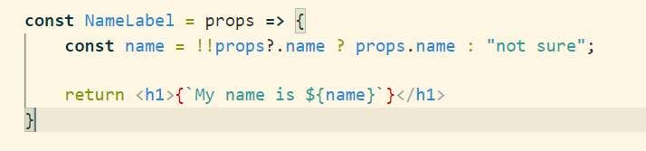
Sample Component
Props is an object with properties
The component should end up adding a heading to the DOM with the given string inserted
Example of a Pure Component as it will return the same output given the same input

Slide 9
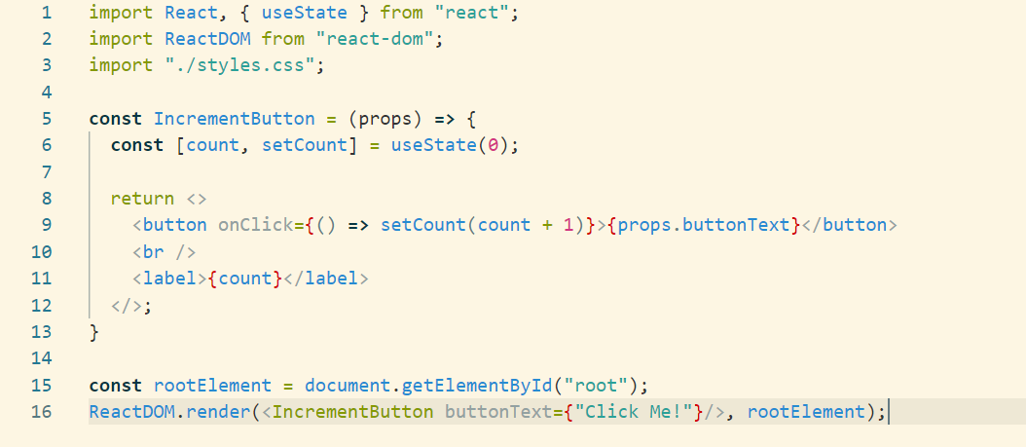
Props and State and the effects on rendering
Any React Component will take in an object known as props that it can use to render itself or its child components
A React Component can also have its own internal state that it manages
The useState hook returns the current value of the property and a function to set the state property
A React Component will render when:
The component is executed again with DIFFERENT props
A state property value is changed via the given function

Slide 10
What is TypeScript
How can it help us in React?

Slide 11
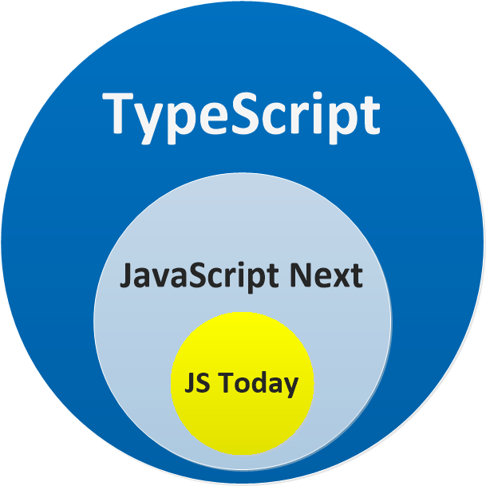
What is TypeScript?
It is a superset of Javascript​ that leverages strong types
It has a transpiler (much like babel) that will transpile your application logic into a known ES standard to ensure browser support​
It is a compiler in the idea of a type checker. It will evaluate the types in the application and ensure everything is written to work together​
It is a way to both explicitly and implicitly describe what you are working with at any given time

Slide 12
Benefits of TypeScript
Types give us a way to ensure that our changes work with the application as written. (Reduction of runtime debugging)​
Types are self-documenting reducing the amount of documentation drift.​
Types allow us to communicate intent for functionality​
Types allow us to identify regression through tooling rather than just inspection or smoke testing​
Most modern IDEs support Typescript meaning the autocompletion and warning alerts are more accurate​
Typescript is widely adopted, so most of your third-party libraries already ship with types, meaning less jumping to online docs​
At the end of the day, we still ship Javascript, so past types, there isn't anything different in the way we write the application​
Encourages ongoing refactors as a contract is established already for functionality​

Slide 13
How to Add Types – Basic Declarations
Basic type assignment to a variable
Inferring types
Describing objects
Describing functions

Slide 14
How to Add Types – User Defined and Composed
User Defined
Composed
Types
Interfaces

Slide 15
How to Add Types – Generics
Generics allow a user to pass a parameter to a type
Some built in examples are Array<T> or Partial<T>
Example in a Function
Example in a Class

Slide 16

Creating a new React app with TypeScript

Slide 17
Converting an Existing React App
Adopting gradually

